Slide 1


Transactions

Slide 2

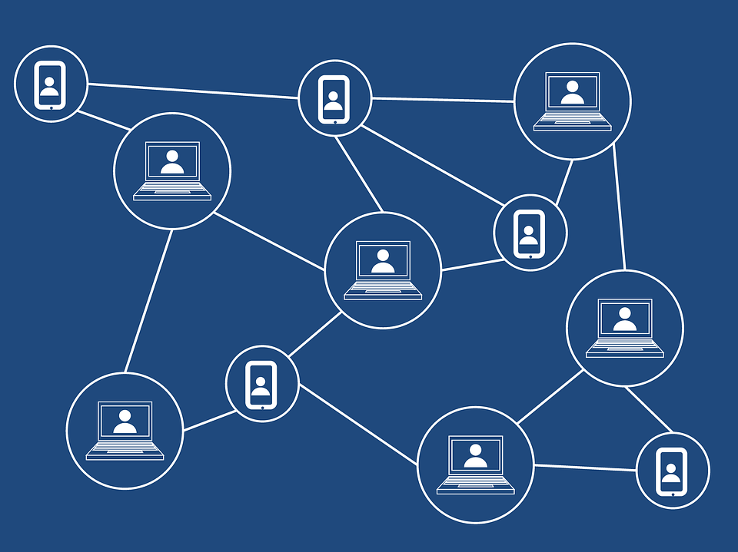
Lecture Checklist
Introduction to Database Transactions.
ACID Properties.

Slide 3
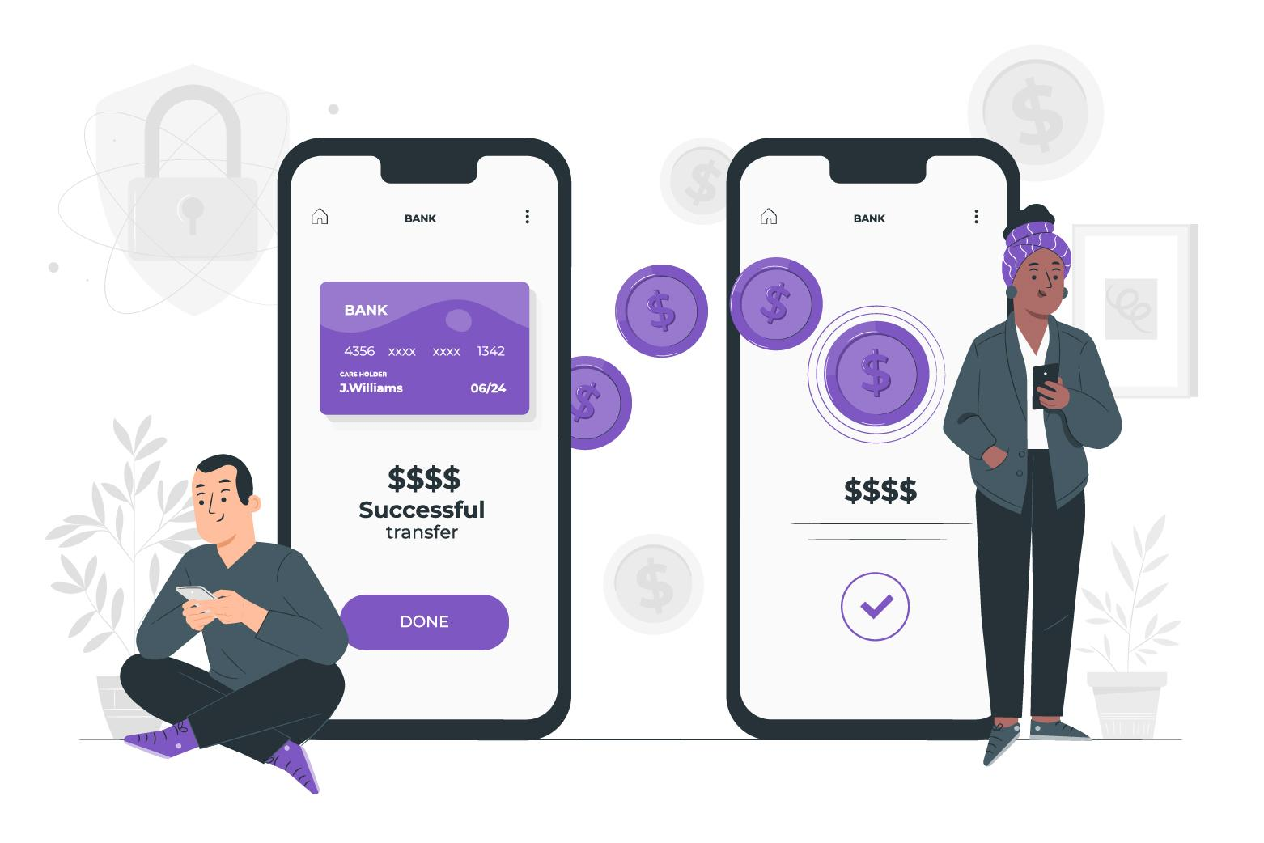
Introduction to Transactions.
Transactions mean either all or nothing.

Slide 4

Introduction to Transactions.
Stages of Transaction

Slide 5
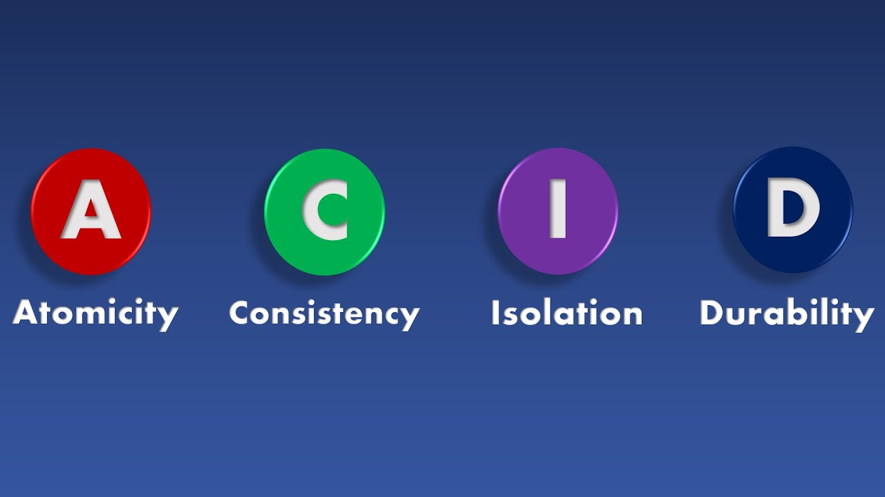
ACID Properties.

Slide 6

Atomicity.

Slide 7
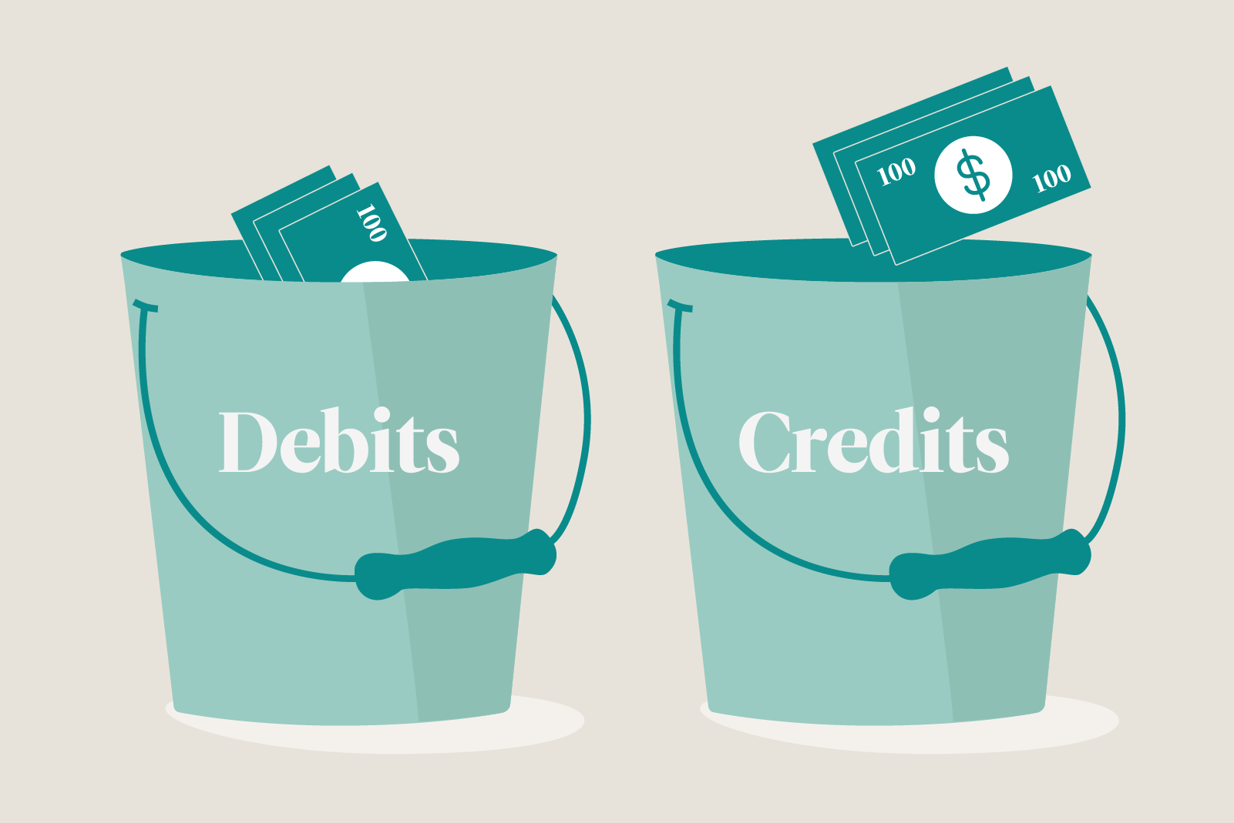
Consistent.

Slide 8

Isolation.

Slide 9
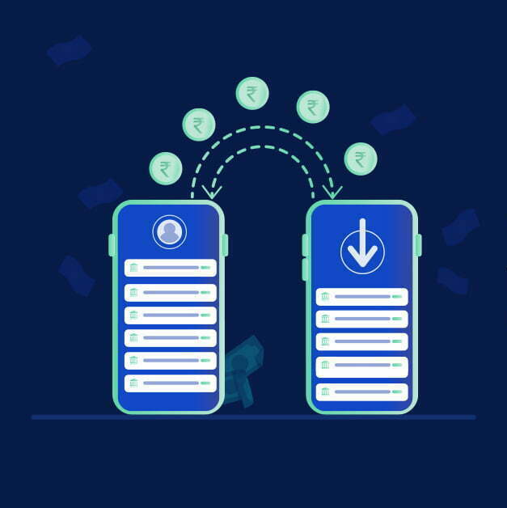
Durability.

Slide 10
THANK YOU

